Slide 1

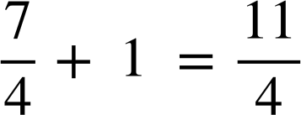
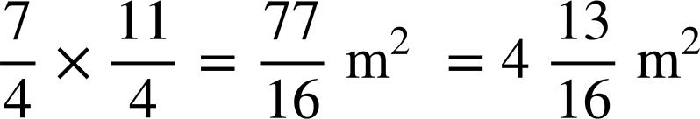
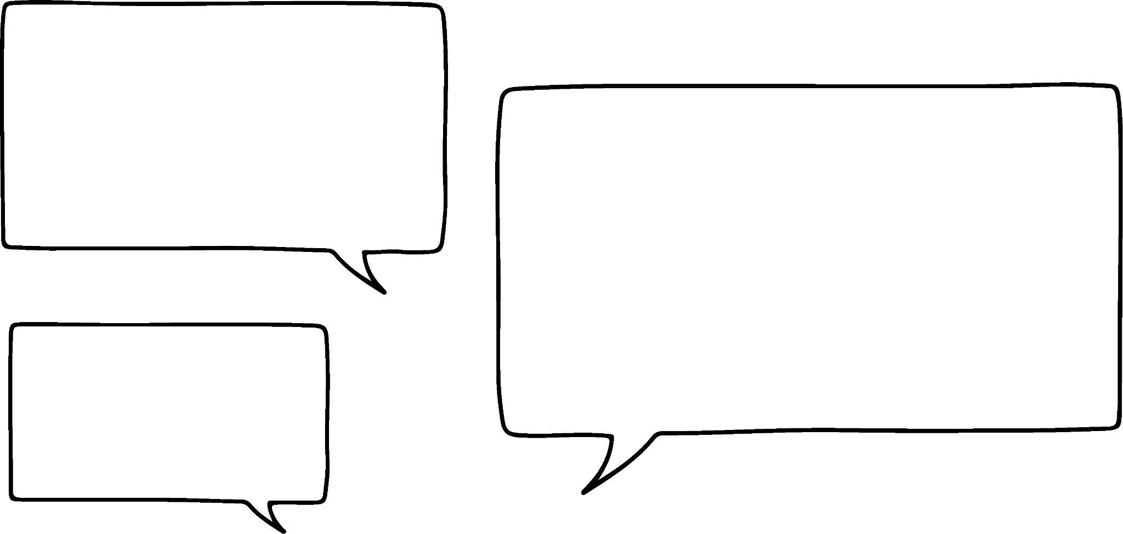

Checking understanding of algebraic notation
Task A: Missing number problems
Solve each problem, you could use a diagram to help you.
a) A recipe for fruit cake requires the same amount of currants and sultanas but twice as many raisins.
Altogether you need 420 g of dried fruit.
How much of each fruit do you need?
b) Jacob was 6 years old when his puppy was born.
At what age would he be exactly double his puppy’s age?
At what age would he be exactly three times his puppy’s age?
420 g
?
6
?
6
?
?
?
?
?
?
?
currants
sultanas
raisins
puppy
Jacob
Jacob would be double the puppy’s age when he is 12
420 ÷ 4 = 105 g
?
6
c = 105 g
s = 105 g
?
r = 210 g
Jacob would be three times the puppy’s age when he is 9
?
?
c) A rectangle is drawn where its length is double its width.
If its perimeter is 24 cm, what is the area of the rectangle?
d) The length of a rectangular cupboard is 1 m longer than its width.
The perimeter of the cupboard floor is 9 m; what is its area?
Leave your answer as a fraction.
?
?
24 ÷ 6 = 4 cm
?
?
?
4 × 8 = 32 cm²
7 ÷ 4 =
1
?
?
?
?
?
1
2a) Sour sweets cost 30 p and toffees cost 25 p.
Laura has £1.70 and wants to spend all her money with no change left over.
How many of each can she buy?
b) Sam has written the equation 2a + 3b = 26
There are two answers to this problem.
a = 4 and b = 6 or
a = 1 and b = 8
Sam
Explain why Sam is incorrect.
4 sour sweets and 2 toffees
Without context, a and b could be negative numbers or decimals so there are an infinite number of answers.

Slide 2
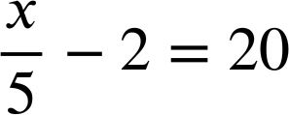
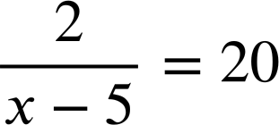
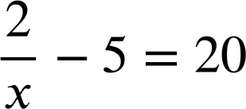
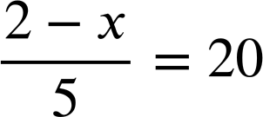
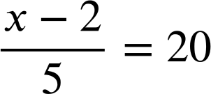
Checking understanding of algebraic notation
Task B: Expressing problems algebraically
Match the bar model to the equation.
a
a)
b)
c)
d)
e)
a + 5 = a + 4x
x
x
x
x
5
5
2a + 5 = 4x + 3
x
x
x
x
a
a
a
5
5 = 4x + a
x
x
x
x
3
a
5
4x + 5 = a
x
x
x
x
a
5
x
a
a + 2x + 3 = a + x + 5
x
x
3
a
2) Match the statements to the equations.
A number minus 2 then divided by 5 equals 20
a)
b)
c)
d)
e)
A number divided by 5 then minus 2 equals 20
2 divided by 5 less than a number equals 20
2 divided by a number then minus 5 equals 20
A number subtracted from 2 then divided by 5 equals 20
Mathematics in Education and Industry
v2.2

